Slide 1
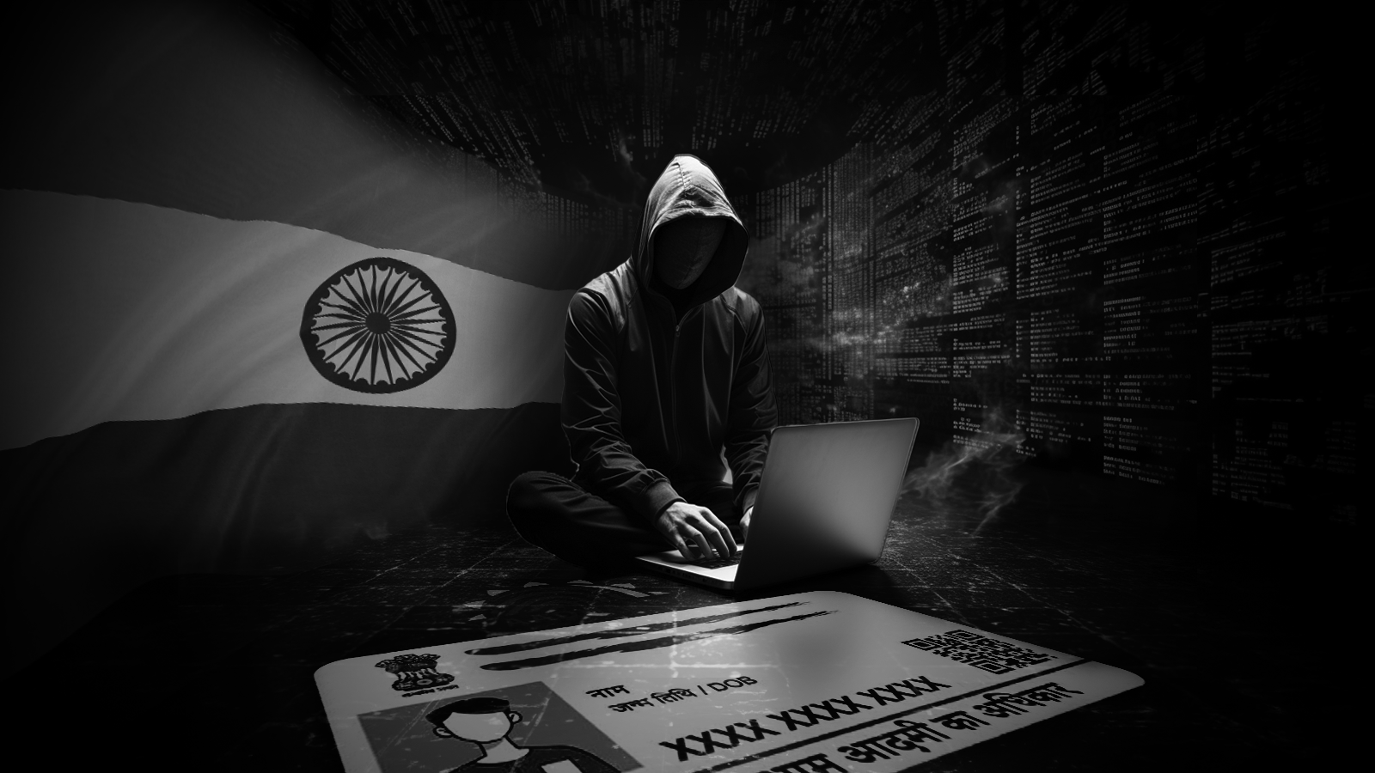
STRENGTHENING CYBERSECURITY MEASURES: PROTECTING INDIAN CITIZEN PII DATA

Slide 2
TABLE OF CONTENTS
01
03
Government and Organizational Response
05
DATA BREACH INCIDENTS
INTRODUCTION
IMPACT ON INDIAN CITIZENS
Conclusion
02
04

Slide 3
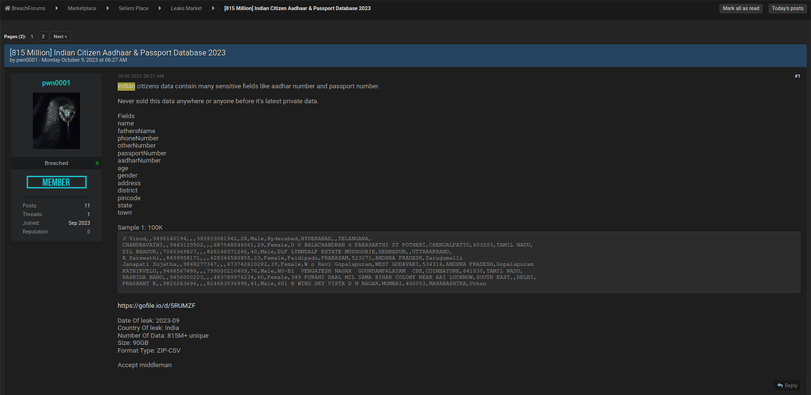
01
INTRODUCTION
HUNTER unit, specializing in Human Intelligence (HUMINT), made a
critical discovery in early October 2023.
The breach involves the sale of a massive number of PII records,
most notably Aadhaar cards, on the Dark Web.
The compromised data is both voluminous and valid,
raising serious concerns about the extent and impact of the breach.
The urgency lies in comprehensively understanding
the cyber threat landscape tomitigate potential fallout.

Slide 4

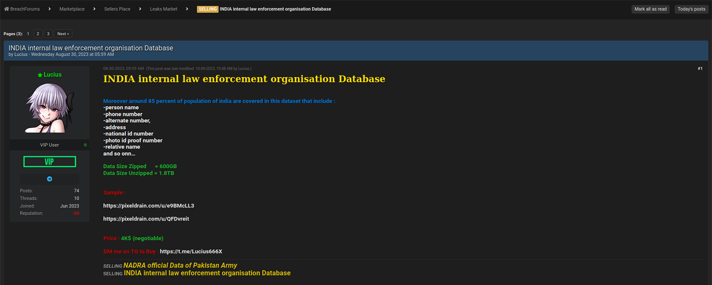
02
DATA BREACH INCIDENTS ON DARK WEB
Threat actor 'pwn0001' orchestrated a significant breach, offering 815 million Aadhaar and passport records on Breach Forums.
The threat actor's willingness to sell the entire dataset for $80,000 indicates the severity of the situation.
The exposed data fields include critical PII, such as names, phone numbers, addresses, and more.
Another threat actor, 'Lucius,' promoted a 1.8 TB data leak with even more extensive PII, including Aadhaar IDs, Voter IDs, and driving license records.

Slide 5
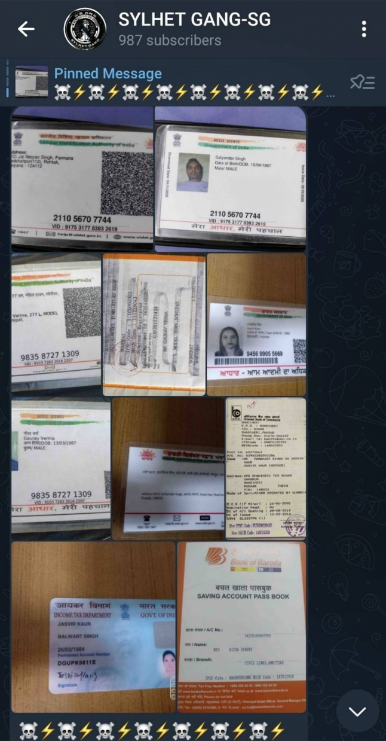
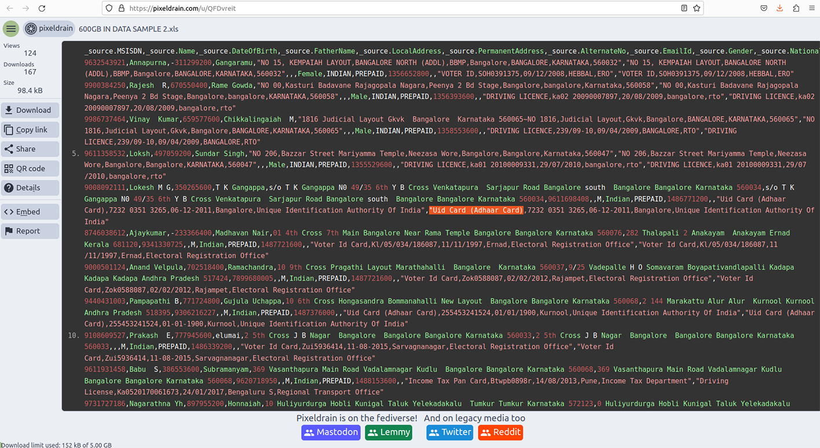
02
IMPACT ON INDIAN CITIZENS
The recent data breach on the dark web has put the personally identifiable information (PII) of millions of Indian citizens at risk. This includes sensitive information such as names, addresses, phone numbers, and even financial information.
CONSEQUENCES FOR INDIAN CITIZENS
The consequences of this breach are far-reaching and potentially devastating for Indian citizens. Cybercriminals can use this information to commit identity theft, financial fraud, and other malicious activities. The breach also undermines trust in government and private institutions tasked with protecting citizen data.
STEPS TO PROTECT INDIAN CITIZENS
To protect Indian citizens from the impact of this breach, it is crucial to strengthen cybersecurity measures and implement stricter data protection laws. This includes investing in advanced security technologies, increasing employee training on cybersecurity best practices, and holding institutions accountable for data breaches.

Slide 6


03
Government and Organizational Response
CERT-In plays a pivotal role in responding to cyber emergencies, but challenges exist, including the lack of citizen awareness.
Identifying and addressing obstacles in incident response is crucial for an effective defense against cyber threats.
Citizen awareness is vital for information dissemination, ensuring affected parties are notified responsibly.

Slide 7
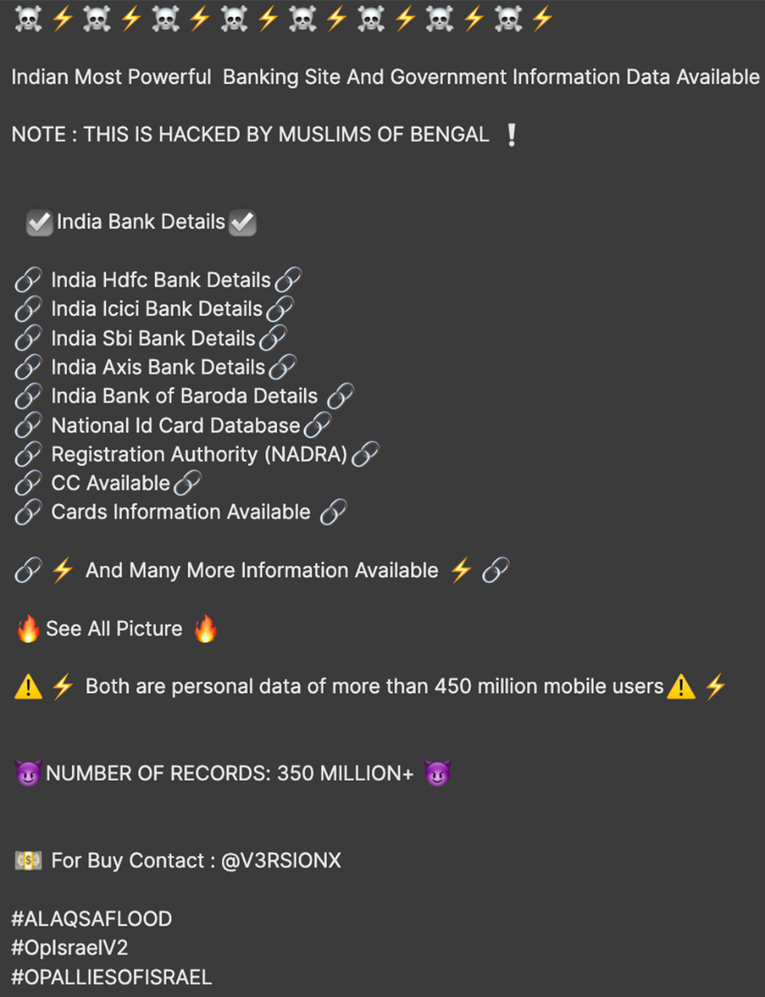

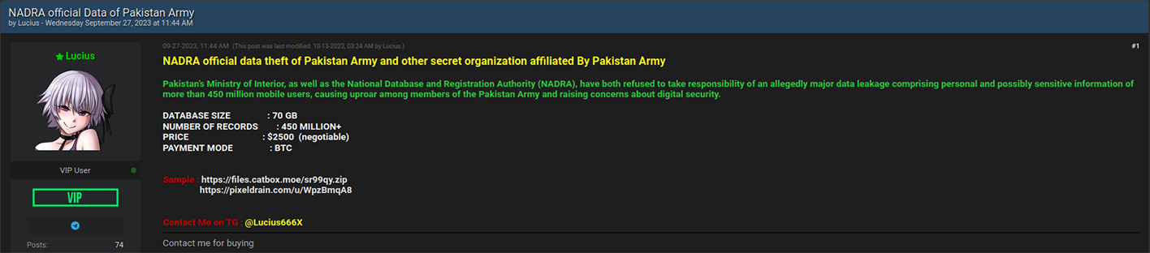
PROOF

Slide 8

PROOF

Slide 9

PROOF

Slide 10
PROOF

Slide 11

PROOF

Slide 12
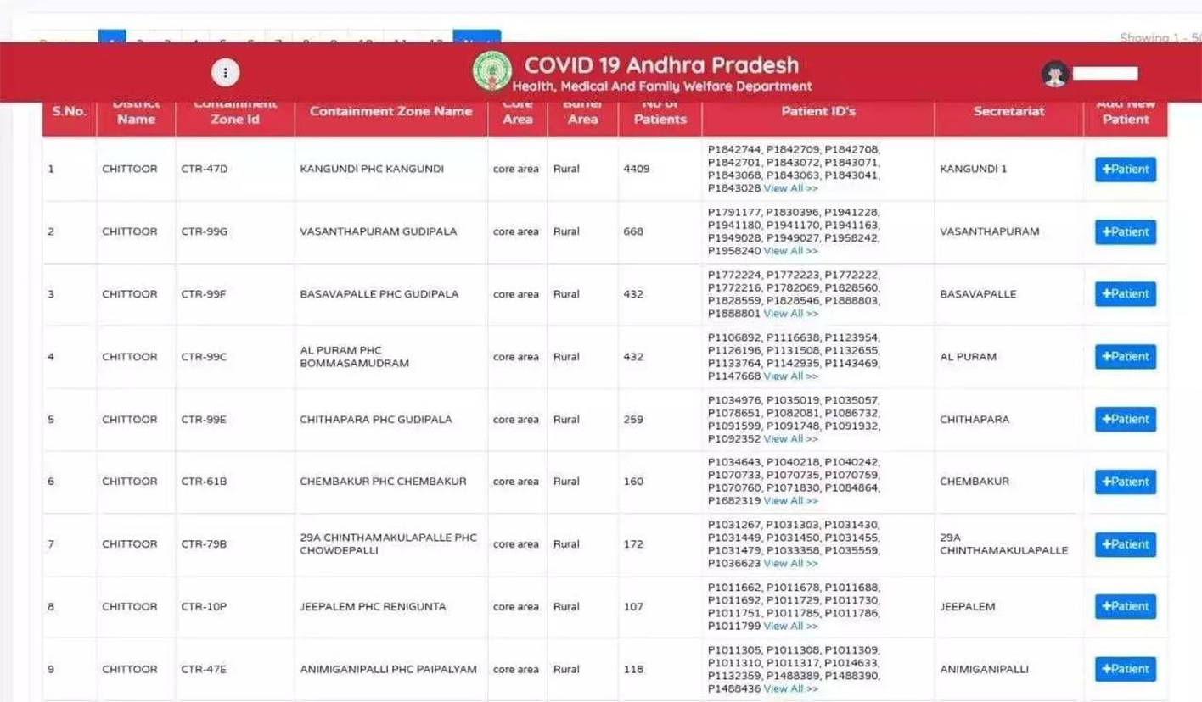
PROOF

Slide 13
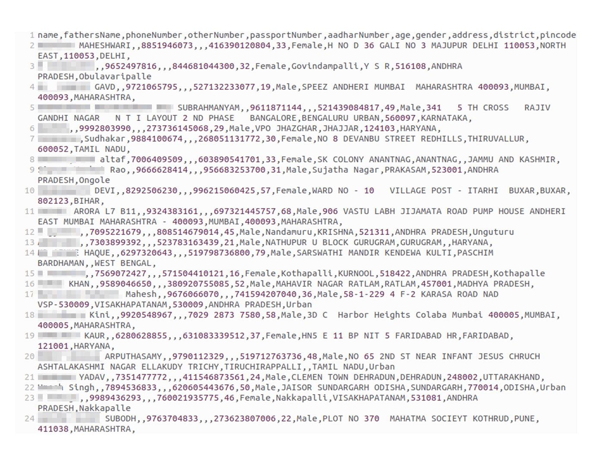
PROOF

Slide 14
02
Conclusion
Urgent need for proactive identity protection strategies to counter the growing threat landscape.
Proposing strategies to build a cyber secure society involves comprehensive measures and collaborative efforts.
Safeguarding citizen information is critical, emphasizing the responsibility of both government and private organizations.

Slide 15

Thank you for Watching
Created &Designed by Praneet

